Slide 1
Stock Market Future Price Prediction
A Data-driven Approach to forcasting Stock Prices
Hardik Lakkad

Slide 2
Objective
We proposed to develop a system that pridicts future stock price based on historical data and pattern
Value Proposition
A well-develop model prediction can help investors improve an investment strategies and portfolio management by 10%-15%
A small improvement in prediction model can a lead significant gain for investors and financial institutions.

Slide 3
Key Areas
Market Trends
Risk Management
01
04
Predictive Modeling
Emerging Technologies
02
05
Factors Influencing Stock Prices
Global Economic Landscape
03
06

Slide 4
Timeline for MVP( Minimum Viable Product)
01
02
03
Data Gethering and Preprocessing
(2 week)
Data Analysis for key insight
(1 week)
Model Selection and Initial Setup
(1 week)
04
05
06
Model Training and Optimization
(1 week)
Model Evaluation and Validation
(1 week)
Deployment and Final Review
(2 week)

Slide 5
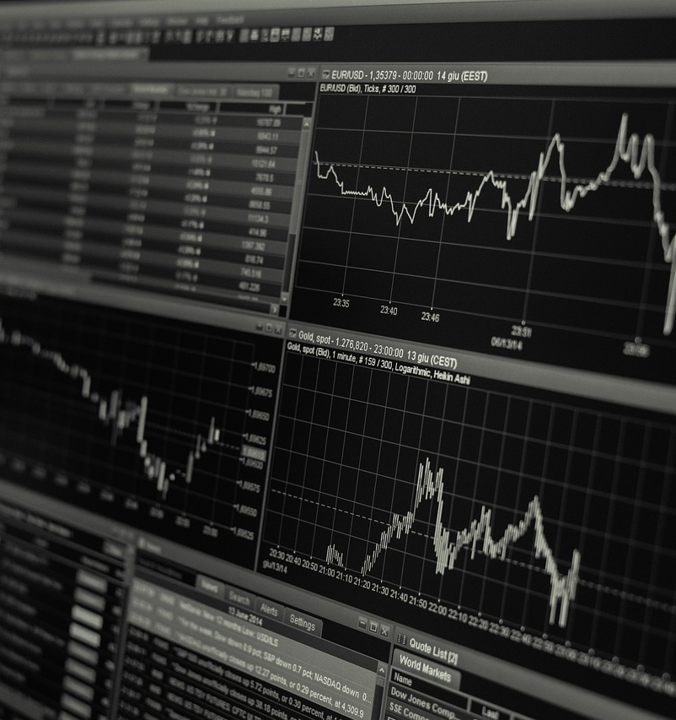
Key Performance Indicators (KPIs)
1. Prediction Accuracy
2. Profit/Loss Impact
3. User Adoption
4. Return on Investment

Slide 6
Resource Requirements
Team Members
Technical
Resources
Business
Support
Data Scientist
Financial Analyst
Software Developer
Historical Data
Real Time Data
Cloud Support
Collaboration With Finance Team
IT Team

Slide 7
Conclusion
Our stock price prediction model has the potential to improve investment decisions by leveraging machine learning technology.
With an 8-week timeline and minimal resource requirements, we can deliver a function MVP to test the model.

Slide 8
Questions and Discussion

Slide 9
Thank You
Hardik Lakkad

